Slide 1


Gamer Zone
(Video Game-Based Recommendation System)
Presented by:
Derrek Beeck
Hans Yabao
Justin Tom
Michael Kozak

Slide 2
What it is
Gamer Zone is video game recommendation system
Based on the user’s preferences it will recommend other similar games
Games will have specific tags that will help connect games to each other

Slide 3
Key Words
Streaming, Gaming, Shovelware, triple A, developer, publisher, indie game, twitch, tags, genre, console, pc, handheld, multiplayer, singleplayer, streamer, YouTuber, game streaming, Esports, tournaments, gaming journalism.

Slide 4


Demographics
Gamerzone is going for multiple demographics but most importantly for gamers looking to find new games to play
The other types of users for our website would include people such as teachers looking for ways to better connect with students about specific topics
Event organizers looking for games to have at their event
Streamers looking for new games to stream
Notes:
Bring up civil war and looking for civil war games

Slide 5
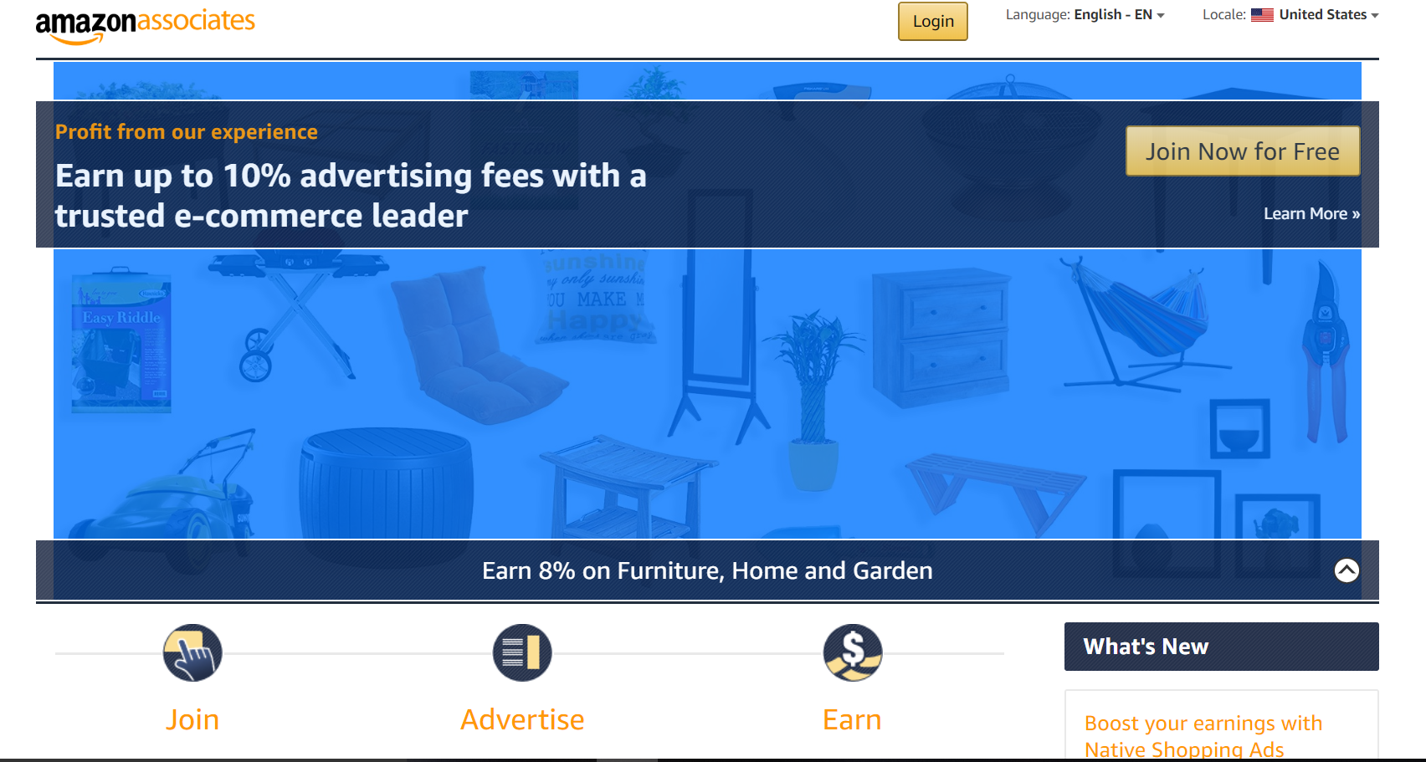
Business Model
The business model involves both amazon affiliate links, advertisements on the website itself, and a premium service
Amazon affiliate links are place on the game’s page and will allow the user to click to open up the Amazon page for the game
Amazon gives the website a small portion of the profits for people who bought the game through the link
Notes:
This page is

Slide 6
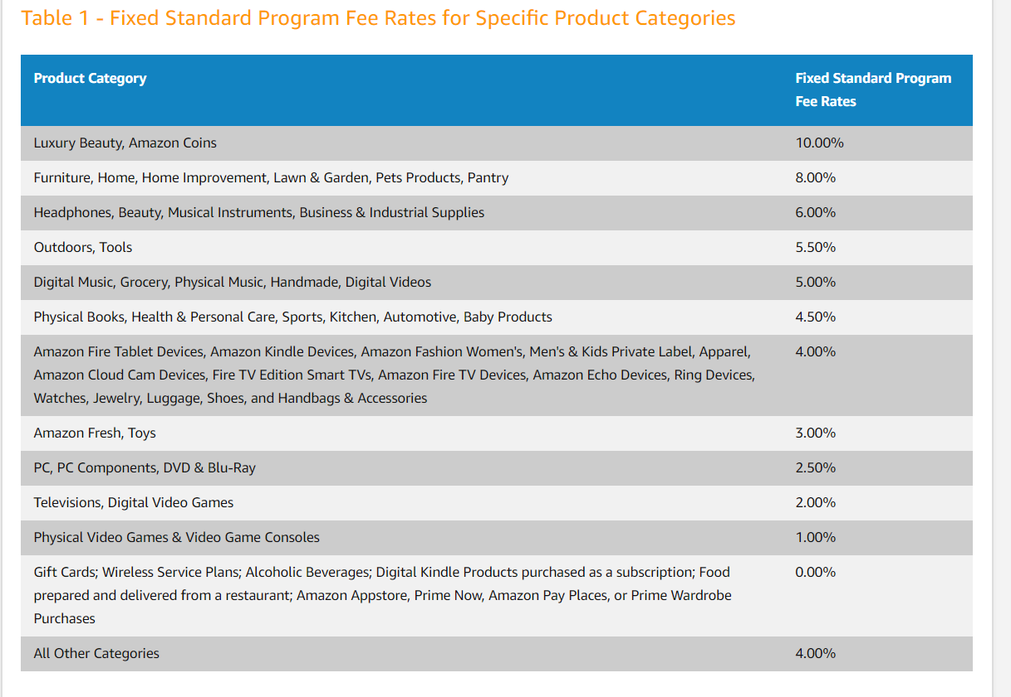
Rates

Slide 7
Advertisements
The other revenue stream will be from advertisements
There are 2 types:
Automatic ones such as google AdSense
Built in Promotions

Slide 8
Google Adsense
Google automatically will placed target ads on your website
You’ll get money based on the amount of pages views you get per month
Estimates for a page getting 50,000 pages views a month would be around $2,500

Slide 9
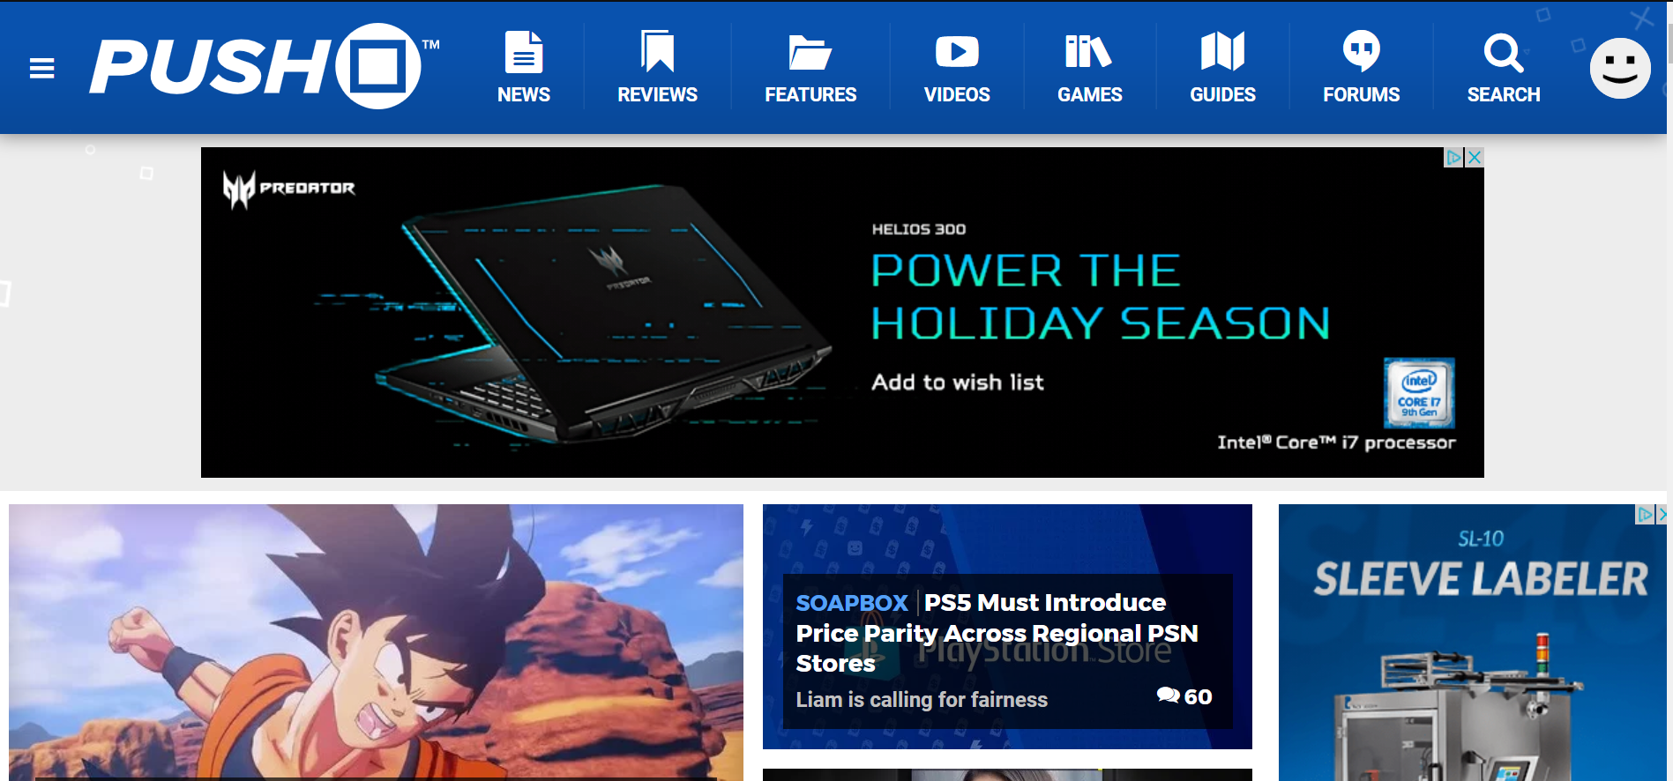
Example

Slide 10
Built in Ads
These ads make more money because the middle-man is cut out
Harder to obtain these ads because the website needs a decent amount of traction for companies to want to do this

Slide 11
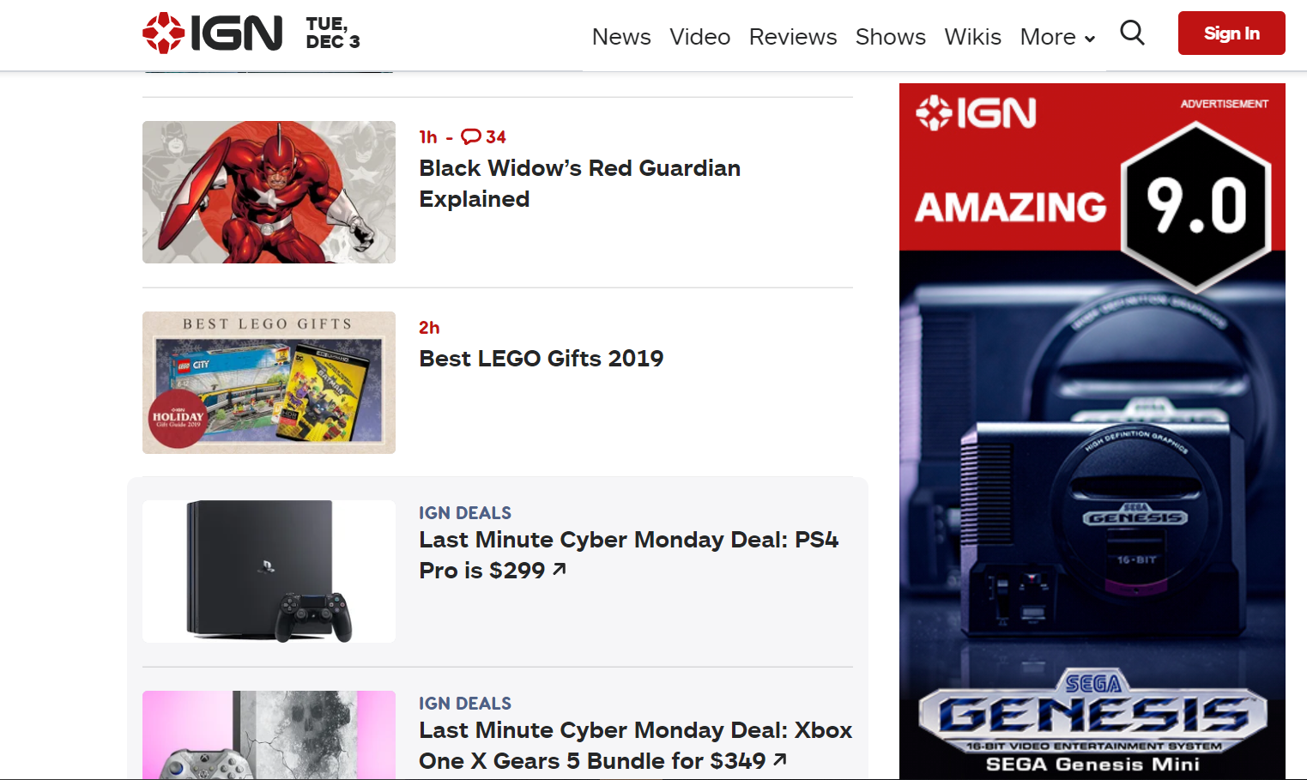

Slide 12

Premium Service
Like with built in ads this would only be able to be implemented after the website gains some traction
Perks for the service could includes things such as no advertisements, exclusive profile badges, premium only podcasts etc.

Slide 13

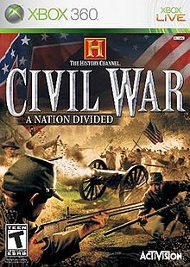
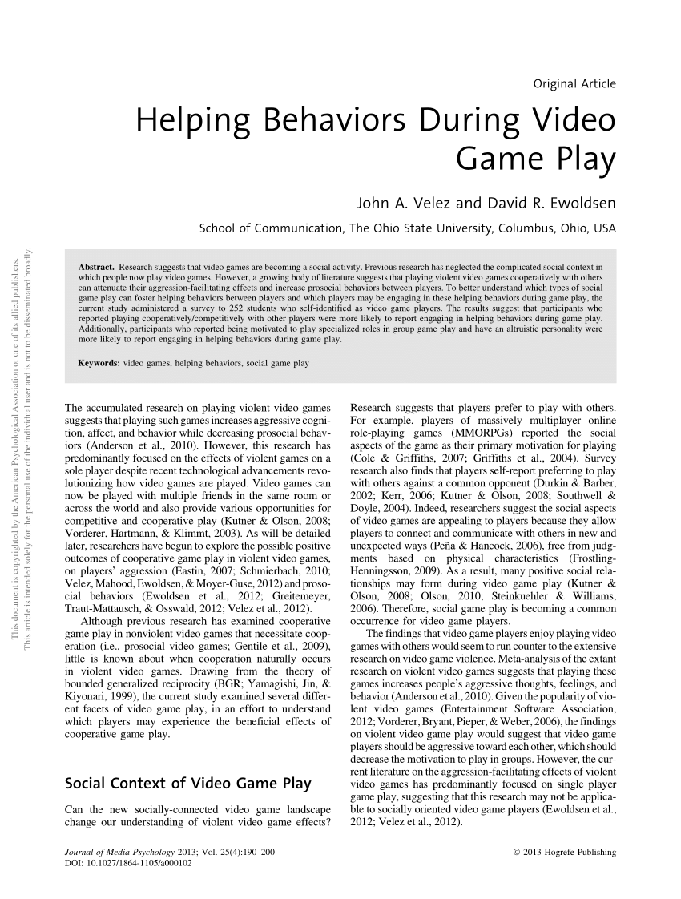
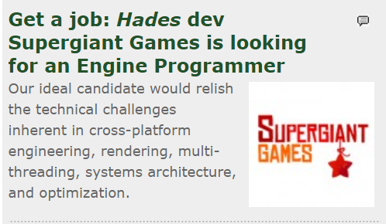
Product Vision
Intention Upon Release:
-Gamer Zone will primarily focus on recommending video games.
In the future...
-Recommend Business/Scholarly articles.
-Recommend other game based media (TV Shows, Movies, Podcasts) that’ll interest user.
Notes:
HANS WILL TALK ABOUT WHAT THE SYSTEM SHOULD BE ABLE TO DO AT LAUNCH
THEN HANS WILL TALK ABOUT WHAT HE WANTS SYSTEM TO DO IN FUTURE

Slide 14
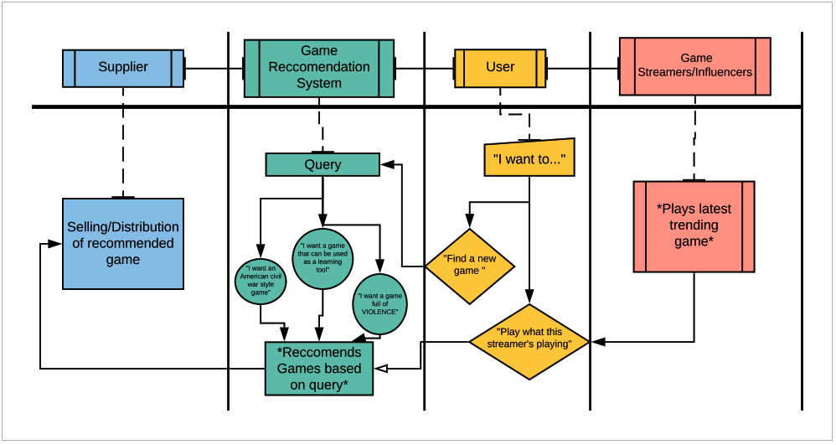
Design Model
Notes:
EXPLAIN CONCEPTUAL PROCESS:
-User wants to inquire about a game
-User queries about what kind of game he wants
-

Slide 15
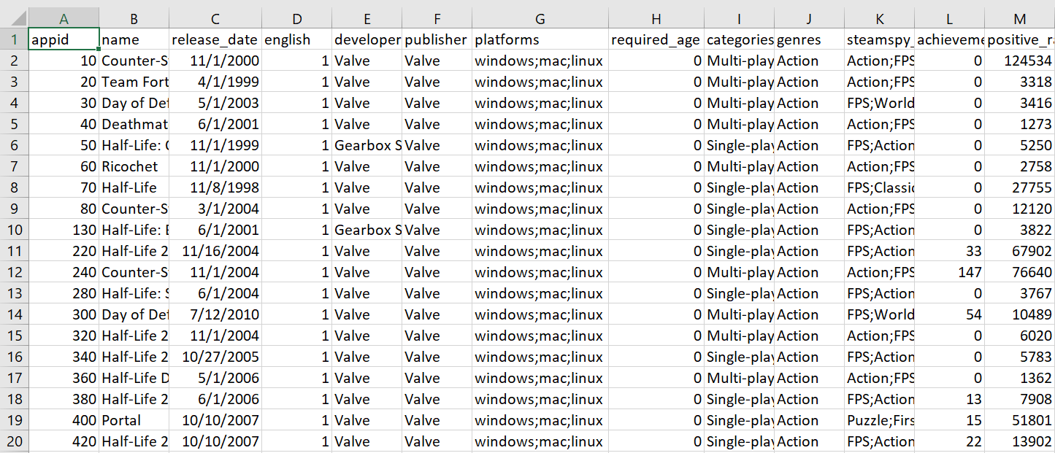
https://www.kaggle.com/nikdavis/steam-store-games

Slide 16
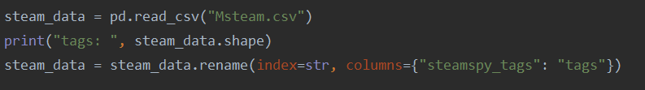
Mock-Up Implementation
Notes:
Michael will Present

Slide 17
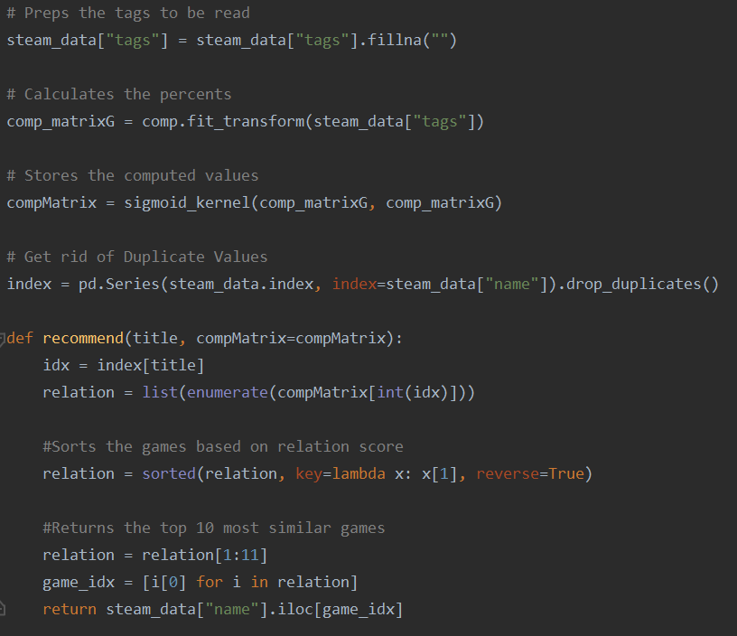
Notes:
Michael will Present

Slide 18
